Slide 1
VLANs
Notes:
Cisco Networking Academy Program
Switching, Routing, and Wireless Essentials v7.0 (SRWE)
Module 3: VLANs

Slide 2
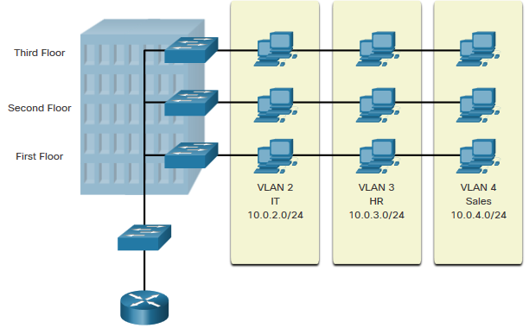
Overview of VLANs VLAN Definitions
VLANs are logical connections with other similar devices.
Placing devices into various VLANs have the following characteristics:
Provides segmentation of the various groups of devices on the same switches
Provide organization that is more manageable
Broadcasts, multicasts and unicasts are isolated in the individual VLAN
Each VLAN will have its own unique range of IP addressing
Smaller broadcast domains
Notes:
3 – VLANs
3.1 – Overview of VLANs
3.1.1 – VLAN Definitions

Slide 3
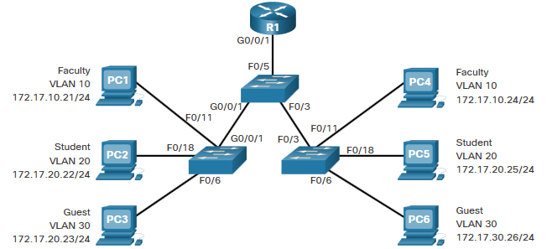
Overview of VLANs Benefits of a VLAN Design
Benefits of using VLANs are as follows:
Benefits | Description
Smaller Broadcast Domains | Dividing the LAN reduces the number of broadcast domains
Improved Security | Only users in the same VLAN can communicate together
Improved IT Efficiency | VLANs can group devices with similar requirements, e.g. faculty vs. students
Reduced Cost | One switch can support multiple groups or VLANs
Better Performance | Small broadcast domains reduce traffic, improving bandwidth
Simpler Management | Similar groups will need similar applications and other network resources
Notes:
3 – VLANs
3.1 – Overview of VLANs
3.1.2 – Benefits of a VLAN Design

Slide 4
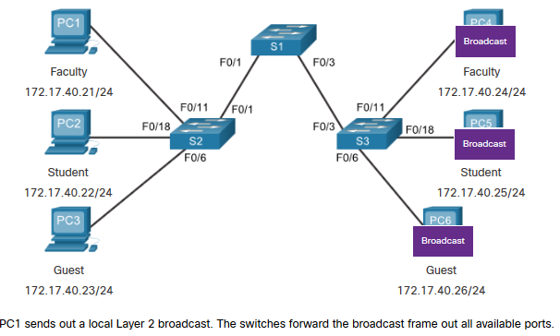
VLANs in a Multi-Switched Environment Networks without VLANs
Without VLANs, all devices connected to the switches will receive all unicast, multicast, and broadcast traffic.
Notes:
3 – VLANs
3.2 – VLANs in a Multi-Switched Environment
3.2.2 – Networks without VLANs

Slide 5
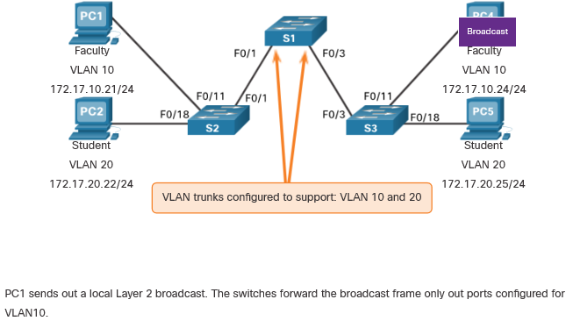
VLANs in a Multi-Switched Environment Networks with VLANs
With VLANs, unicast, multicast, and broadcast traffic is confined to a VLAN. Without a Layer 3 device to connect the VLANs, devices in different VLANs cannot communicate.
Notes:
3 – VLANs
3.2 – VLANs in a Multi-Switched Environment
3.2.3 – Networks with VLANs

Slide 6
3.3 VLAN Configuration
Notes:
3 – VLANs
3.3 – VLAN Configuration

Slide 7
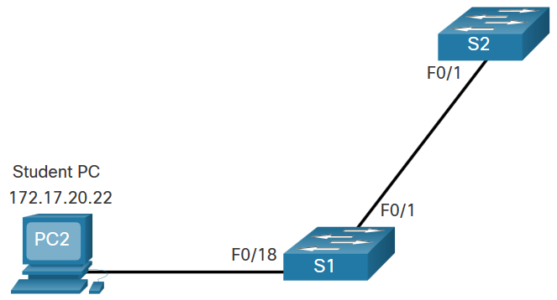
VLAN Configuration VLAN Creation Example
If the Student PC is going to be in VLAN 20, we will create the VLAN first and then name it.
If you do not name it, the Cisco IOS will give it a default name of vlan and the four digit number of the VLAN. E.g. vlan0020 for VLAN 20.
Prompt | Command
S1# | Configure terminal
S1(config)# | vlan 20
S1(config-vlan)# | name student
S1(config-vlan)# | end
Notes:
3 – VLANs
3.3 – VLAN Configuration
3.3.3 – VLAN Creation Example

Slide 8
VLAN Configuration VLAN Port Assignment Commands
Once the VLAN is created, we can then assign it to the correct interfaces.
Task | Command
Enter global configuration mode. | Switch# configure terminal
Enter interface configuration mode. | Switch(config)# interface interface-id
Set the port to access mode. | Switch(config-if)# switchport mode access
Assign the port to a VLAN. | Switch(config-if)# switchport access vlan vlan-id
Return to the privileged EXEC mode. | Switch(config-if)# end
Notes:
3 – VLANs
3.3 – VLAN Configuration
3.3.4 – VLAN Port Assignment Commands

Slide 9
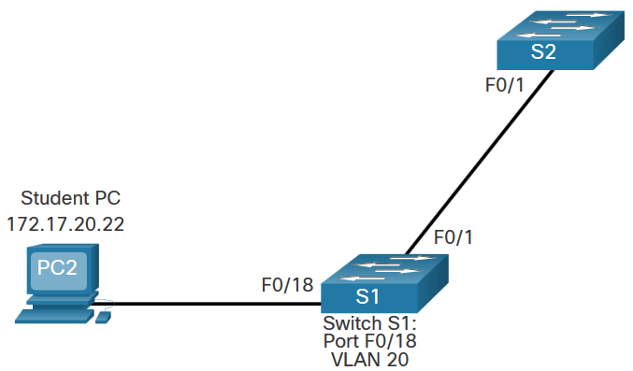
VLAN Configuration VLAN Port Assignment Example
We can assign the VLAN to the port interface.
Once the device is assigned the VLAN, then the end device will need the IP address information for that VLAN
Here, Student PC receives 172.17.20.22
Prompt | Command
S1# | Configure terminal
S1(config)# | Interface fa0/18
S1(config-if)# | Switchport mode access
S1(config-if)# | Switchport access vlan 20
S1(config-if)# | end
Notes:
3 – VLANs
3.3 – VLAN Configuration
3.3.5 – VLAN Port Assignment Example

Slide 10
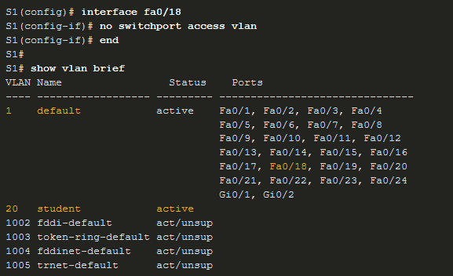
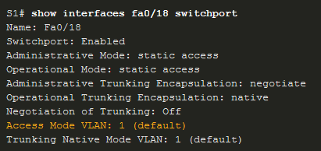
VLAN Configuration Change VLAN Port Membership
There are a number of ways to change VLAN membership:
re-enter switchport access vlan vlan-id command
use the no switchport access vlan to place interface back in VLAN 1
Use the show vlan brief or the show interface fa0/18 switchport commands to verify the correct VLAN association.
Notes:
3 – VLANs
3.3 – VLAN Configuration
3.3.9 – Change VLAN Port Membership

Slide 11
VLAN Configuration Delete VLANs
Delete VLANs with the no vlan vlan-id command.
Caution: Before deleting a VLAN, reassign all member ports to a different VLAN.
Delete all VLANs with the delete flash:vlan.dat or delete vlan.dat commands.
Reload the switch when deleting all VLANs.
Note: To restore to factory default – unplug all data cables, erase the startup-configuration and delete the vlan.dat file, then reload the device.
Notes:
3 – VLANs
3.3 – VLAN Configuration
3.3.10 – Delete VLANs
3.3.11 – Syntax Checker – VLAN Configuration

